Slide 1

Ansible, Chef, Puppet

Slide 2

Agenda
Overview of tools (common features, concepts)
Demo with Ansible
Ansible AWX (maybe…)

Slide 3

What Problems Are We Solving?
“As an Infrastructure Engineer, I want to implement configuration management, so that our systems are configured in a consistent way”
Lack of existing tooling (ie. Doing things manually)
Inadequate/inappropriate/legacy tools
Newer tools offer better capability/outcomes
Notes:
Start with the problem we are trying to solve. A typical user story. Being able to do things consistently is a core part of what we do because our job often involves repetition. Sometimes we don’t get consistency for various reasons
The lack of existing tools may also be a problem we’re trying to solve. Maybe your organisation doesn’t have the size or budget for something like SCCM, so you're left to do things manually.
Another scenario is you may be using tools that are inadequate or legacy. They may be perfectly fine for onprem systems but not for the reality of cloud
Lastly, newer tools may offer better capabilities or outcomes, allowing you to deliver more benefits for yourself and your business

Slide 4
Common Elements
Use of code repositories
Domain specific language (DSL)
Extensibility/Code reuse (layering)
Community involvement
Dev/test workflows
Notes:
Common elements of these tools
The code is stored in repos on somewhere like github, gitlab, etc
All 3 use a DSL, which allows a level of abstraction from the underlying language/technology used.
All 3 can have functionality extended via the creation of “modules”, which can be reused.
All 3 tools have significant community involvement. The most obvious examples of these are the portals where people can publish their code for use by others – Ansible Galaxy, Chef Supermarket and Puppet Forge
Lastly, all three have some form of dev/test workflow where you can develop new code and test it safely against a single test VM before making it more widely available

Slide 5
Code Management
 | Ansible | Chef | Puppet
Repo Model | Multiple | Multiple | Monolithic
Features | Branches | Branches | Branches
Environment Control | Inventory files | Environment Files | Branches
Version Control | Releases | Releases | Puppetfile*
Notes:
Puppetfile used to control version of modules used

Slide 6
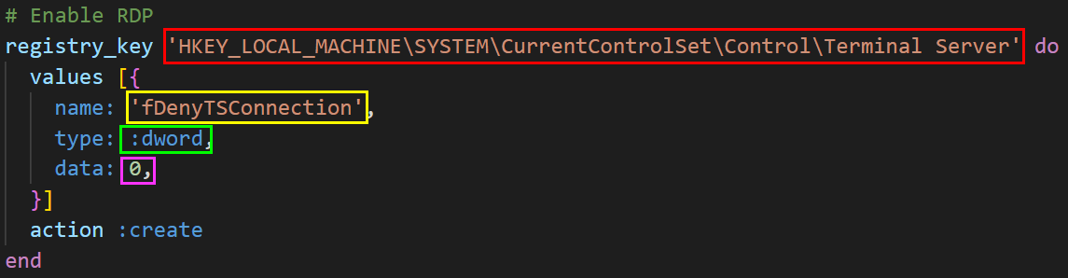

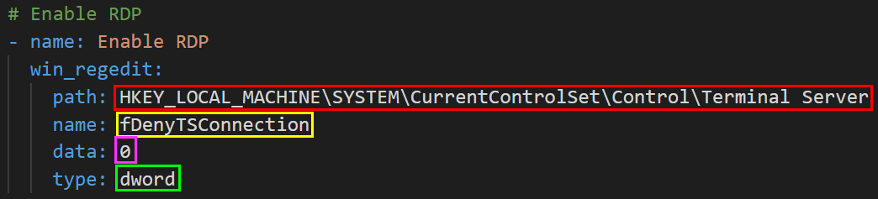

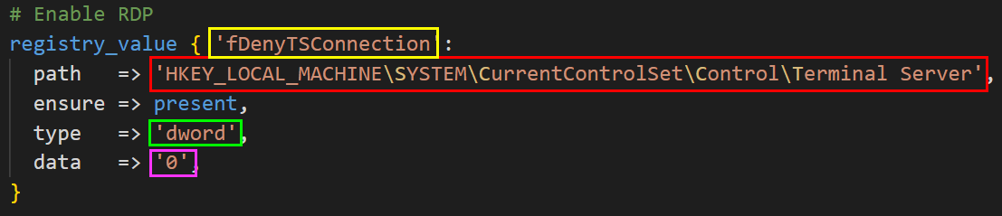
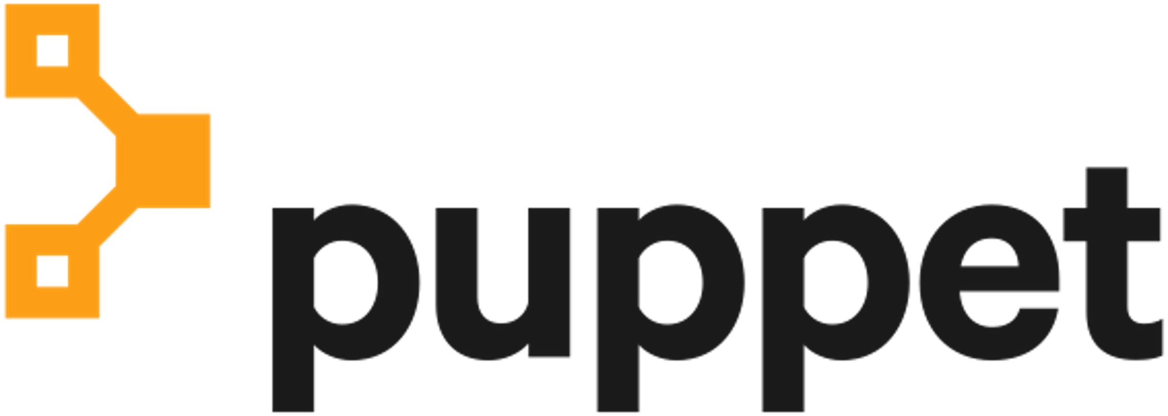
DSL Example

Slide 7



Community
~3,900 cookbooks
~79,000 members
436 for Windows
~6,500 modules
~2,300 contributors
663 for Windows*
~24,900 roles
~21,900 members
305 for Windows
Notes:
Some stats about the community sites for each tool. It’s worth poining out that the Puppet Windows number includes a lot of deprecated items. In general, Puppet modules seem to not be updated that regularly, while Ansible and Chef items do.

Slide 8
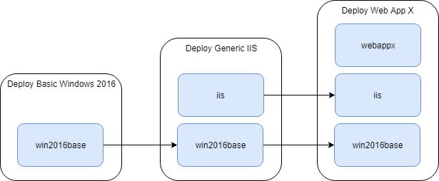
Code Reuse
Code can be boxed into functional units for reuse
Community sites or internal work
Sometimes called Roles
Allows overrides for specific scenarios
Notes:
These tools allow code to be boxed into functional used for reuse. This could be sourced from the community sites mentioned earlier or from your organisation’s own internal development efforts. Sometimes this is called roles, especially if the functionality is around an outcome. A benefit of this approach is it allows the use of overrides at each level.
On the right is a diagram showing how this might work. You might create a role called “win2016base” that is your server SOE. Being your SOE, it would be part of the deployment of a basic server or an application specific server. Layering on top of that could be an IIS role for a generic IIS server, which does a basic install and configuration of IIS. Lastly, you might have a scenario to deploy a specific web application. The configuration required for that could be bundled up and applied as a 3rd layer.

Slide 9

Dev/Test Workflow
Typically uses a local hypervisor and Vagrant to provision a VM
Code is injected and executed
Test suites can be run
Tools: Test Kitchen (Chef), kitchen-puppet (Puppet), Molecule (Ansible)
3rd Party: Appveyor, TravisCI
Notes:
All 3 products have some form of dev/test workflow. This typically involves developing on a local copy of a repo, and a local hypervisor like Virtualbox combined with vagrant to rapidly provision a VM for testing purposes. During this testing, the code from that local copy is injected into the test VM and executed. It’s possible to define test suites to validate the configuration is correct. Some of these tools include Test Kitchen for Chef, while Puppet has a Test Kitchen addon called kitchen-puppet. Lastly Ansible uses Molecule.
There are also 3rd party tools for doing this workflow like Appveyor and TravisCI. When looking at some of the code on the community sites, you may sometimes see reference to these, where automated test cycles are executed on the code.

Slide 10
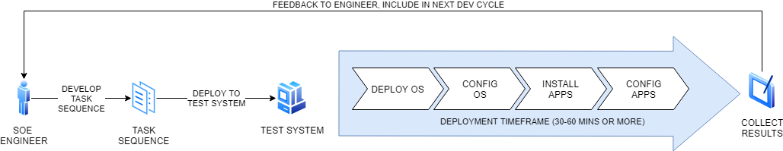
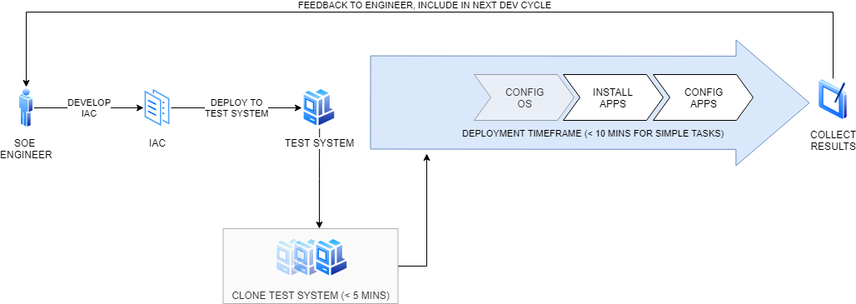
Dev/Test Workflow
Notes:
In terms of benefit for this workflow, one of the main ones is the time for us to get feedback. The top workflow represents the typical experience of working on something like a SCCM task sequence. Because OS deployment, OS configuration, app installation and app configuration are all part of the same sequence, we have to execute the entire sequence when doing our dev-test-feedback cycle. This can take up to an hour or more, depending on what’s being done during the sequence.
Using tools like Vagrant, the OS is effectively deployed and configured as part of the VM template being used. All we’re doing is creating a clone, which can be very rapid if you’re using a decent PC. Because we’re removing the OS deploy and OS config tasks, the deployment timeframe can be reduced, giving us feedback much faster. This sort of compacted feedback loop allows very rapid iteration of code, leading to faster delivery.

Slide 11
Characteristic Comparison
 | Ansible | Chef | Puppet
Initiator | Control Machine | Agent | Agent
Protocol | SSH/WinRM | TCP/8000 | TCP
Push/Pull | Push | Pull | Pull
Adhoc Tasks | Yes | Yes (via Push Jobs) | Yes (via Bolt)
Base Units | Tasks | Resources | Resources

Slide 12
Controlling Behaviour
Chef uses “guards”
Ansible uses the “when” task modifier
when: ‘ansible_distribution == “RedHat”’
Notifications
“Only do X if Y has changed”
Restart Service X if config file is changed
Notes:
One concept that is important is controlling the behaviour of our code. Chef calls these guards, Ansible calls them task modifiers. In truth, there’s already transparent controls in place that prevent needless re-execution of code, but sometimes we want more granular control. An example might be when a particular OS type or version is in use and we need to handle things differently. Another form of controlling behaviour is Notifications, where events from one action can inform another – generally in the form of “only do X if Y has changed”. A common example of this is to restart a service only if a configuration file has changed.

Slide 13
Desired State
Bring a system to a defined Desired State
Process similar to DSC’s Get-Test-Set process to check current state vs Desired State
Some resource types don’t work well in this
Repeated runs ensure enforcement, address config drift*
Related concepts – convergence, idempotence
Notes:
All three of these tools aim to bring a system to a desired state that’s defined in the code we write
This process is similar to Powershell DSC and its Get-Test-Set model, used to check current state against Desired state.
Some resource types don’t work well in this model, like anything that executes a command. To our tool, this creates a black box where it has no visibility of what happens inside it and all it gets is a return code. So where possible it’s best to avoid using these resources
Repeated runs ensure our desired state is enforced and deal with configuration drift, like GPO. However it only addresses configuration drift in the scope of what we define in our desired state (so people could still screw around with stuff outside that scope)

Slide 14
Convergence & Idempotence
Convergence: bringing the system state to meet the desired state
Best case scenario – the tool needs one pass to converge the system to the desired state
Idempotence: where a piece of code, if executed, will yield the same result every time
Notes:
2 concepts important to desired state and also constructing good code in Ansible, Chef and Puppet are Convergence and Idempotence. Convergence is about the process of getting from our current state to the desired state detailed in our code. The best case scenario is only one execution cycle is needed to “converge” a system. If this happens, in subsequent execution cycles, nothing is done because we’re already at Desired State. In some cases, this is not possible. For example, if our sequence of tasks requires a reboot, the first cycle will be interrupted, and a 2nd cycle started post-reboot.
Idempotence is a word that was mentioned in Jeffrey Snover’s manifesto that led to Powershell. It’s really about consistency in execution. If I run a piece of code, it should yield the same results the first time or the 1,000th time it’s run. This is about ensuring our code can handle the varying factors in the environment it runs in.

Slide 15
Real World Use Cases
Server SOE/Baseline
Database (MS SQL, mySQL)
Web (IIS, Apache)
Hardening (CIS/DISA STIG)
Notes:
A lot of this content so far has probably been very abstract, since it’s around concepts. And it’s good to link it all back to some real world examples of how these tools have been applied. Firstly, it can absolutely be used to apply your server SOE or baseline configuration. Going back to what I said about code reuse, doing your SOE with these tools will give biggest return on effort because it’ll be used on every single server. Database software is another example. At a prior job, I worked on a POC that included standing up SQL server using Puppet. This was quite a customised configuration that the organisation had defined, with things like custom ports, as well as maintenance tasks that had to be configured. Web servers are another use case as well.
Lastly, hardening your systems is a good use case. I’ve personally done hardening of Windows 2016 using Chef and 2019 using Puppet, both times used the CIS benchmarks as the starting point.

Slide 16
DEMO TIME!
Notes:
Yay demo time

